Slide 1

An OpenPulse mock backend for spin-based qubits
#22
Members:
Farai Mazhandu
Solomon Uriri
Gift Letsoalo
Sunday A. Ajagbe
Tiberius Tabalu
Coach: David Ittah
Building an OpenPulse mock backend for a new quantum device based on nitrogen vacancy centres:
Interaction of electron spin with 13C nuclear spin (hybrid quantum system)
#qiskit-camp-Africa-2019

Slide 2
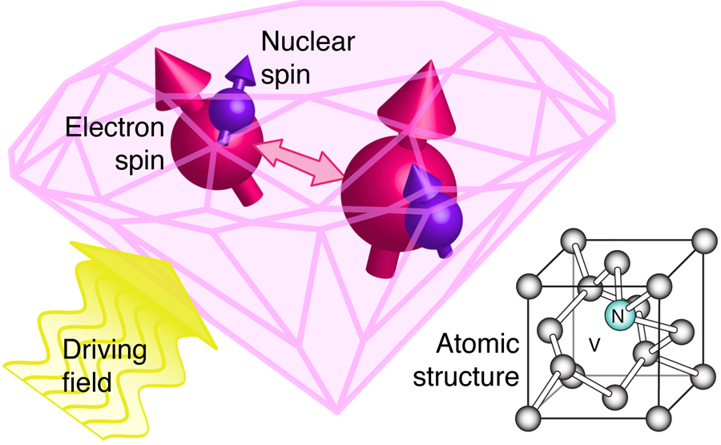
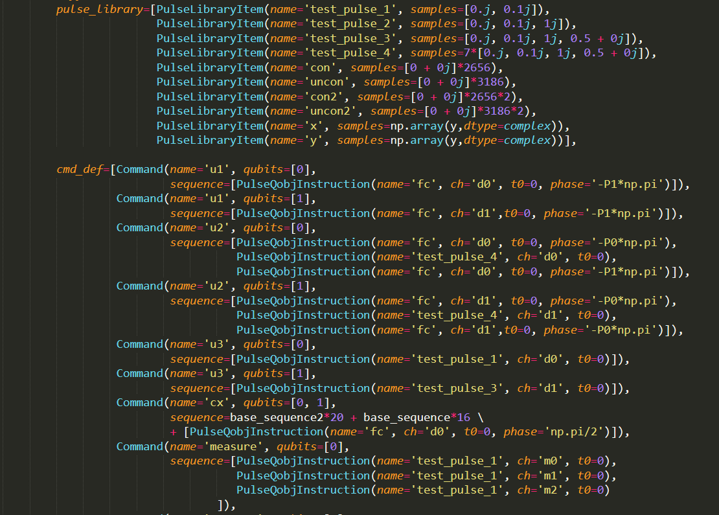
Problem definition:
Nitrogen vacancy centers are a promising quantum hardware platform due to low decoherence and fast manipulation of the independent electron spin.
Up to today Qiskit only supported SCs and Trapped Ions. OpenPulse had no backend to test spin based quantum hardware.
There is need for a faked backend to test operations that are possible on quantum hardware based on nitrogen vacancy centers.
What we did:
We wanted to set-up gate sets for new quantum hardware based on spin and then realised Qiskit is already set-up for that. It is at much lower level where work had to be done...pulse sequences to be exact and OpenPulse was a natural destination.
Build a 2Q mocked backend and here is our code.
#qiskit-camp-Africa-2019

Slide 3
Limitations and challenges:
Breaking down the problem to a level where people from different backgrounds could understand.
All our gates are implemented via the electron which makes the system very complicated to break down.
Dynamic decoupling sequences are complicated and take time to get around.
Future directions:
The initialization routine is has to be developed
Find an efficient way to carry out SWAPs
Calibrate the mock the backend
Benchmarking to quantify performance and know areas of improvement
Acknowledgements: The whole team and our coach-David Ittah and IBM coaches Nick and Lauren.
#qiskit-camp-Africa-2019

